Slide 1

HealthCare: Persistency of a Drug
Group Name: The Data Doctors
Ashish Sasanapuri, Mohammad Shehzar Khan, Tomisin Abimbola Adeniyi
30-Dec-2023

Slide 2
Problem Description
One challenge for all Pharmaceutical companies is to understand the persistence of a drug as per the physician's prescription. To solve this problem ABC Pharma company approached an analytics company to automate this process of identification.

Slide 3
Data Understanding
The dataset provides the factors impacting the patient’s persistence to New Therapy Medication
(NTM) by ABC pharmaceutical company prescribed by various physicians.
The aim is to build a machine-learning model that classifies the patient into Persistent
(Compliant) and Non-persistent (Non-Compliant).
The dataset consists of 3242 records and is a an imbalanced dataset due to low number of
Persistent records as compared to Non-persistent.

Slide 4
Data Understanding
The dataset contains a total of 69 features that are divided into multiple categories -
1 Target variable: Persistency_Flag
1 Unique identifier for each patient: Ptid
6 Demographic variables of the each patient: Age_Bucket, Gender, Race, Ethnicity, Region, Idn_Indicator
3 Physician Specialist attributes: Ntm_Speciality, Ntm_Specialist_Flag, Ntm_Specialist_Bucket
13 Clinical factors: T-Score details, Risk_Segment details, Multiple risk factors count, DEXA details, Fragility fracture details, Glucocorticoid details
45 Disease/Treatment factors: Injectable drugs, Risk factors, Comorbidities, Concomitancies,
Adherence to therapy

Slide 5
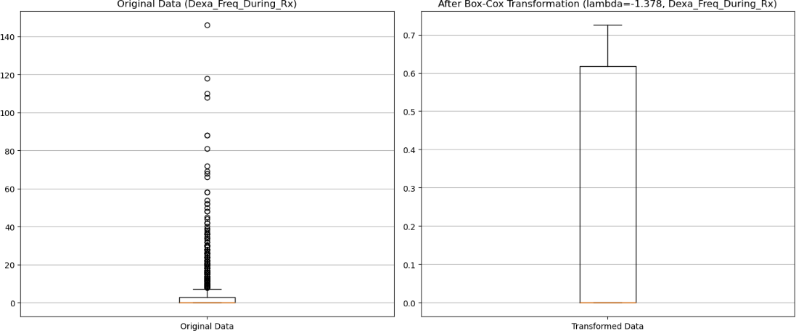
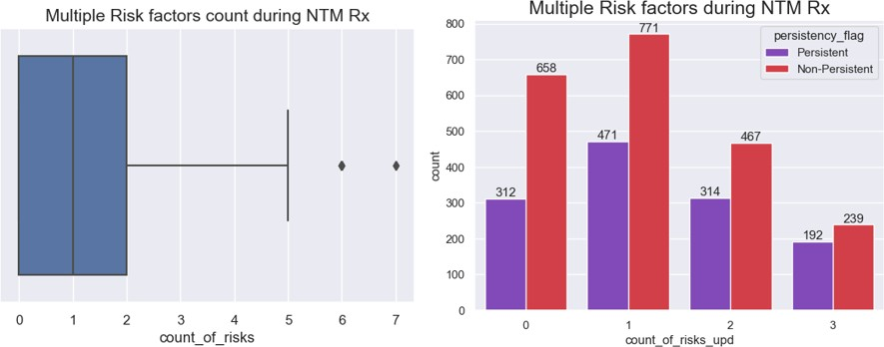
Data Preprocessing
Outliers Detection and Handling: 2 features contain outliers – Dexa_Freq_During_Rx and
Count_of_Risks.
Handled outliers in Dexa_freq_During_Rx using Box-cox transformation.
Reduced category count from 0 – 7 to 0 – 3 where 3 signifies number of risks a patient suffers at the same time more than or equal to 3.

Slide 6

Data Analysis

Slide 7
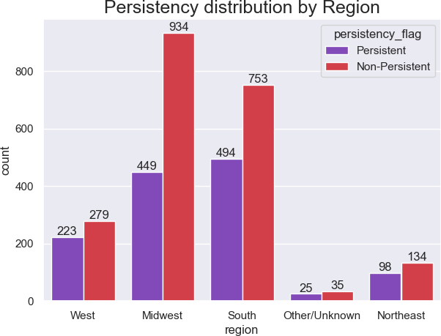
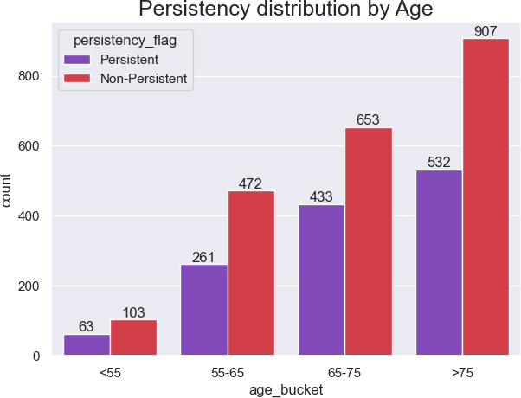
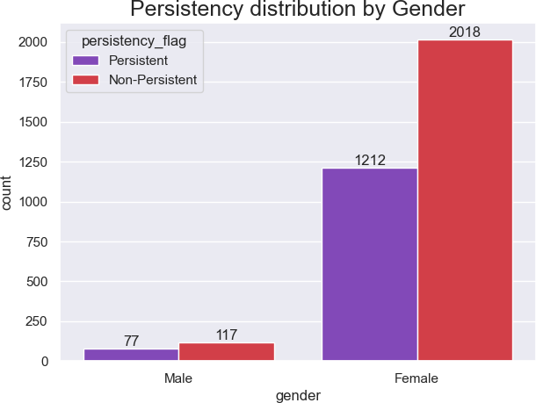
Demographic Data
Majority of the patients recorded are Females and most of them are Non-Persistent to NTM therapies.
We can observe that majority of the patients are aged above 55 years and majority Non-Persistent
patients fall in the age group of more than 75 years of age.
Midwest, South, and West regions display majority of the patients recorded.

Slide 8
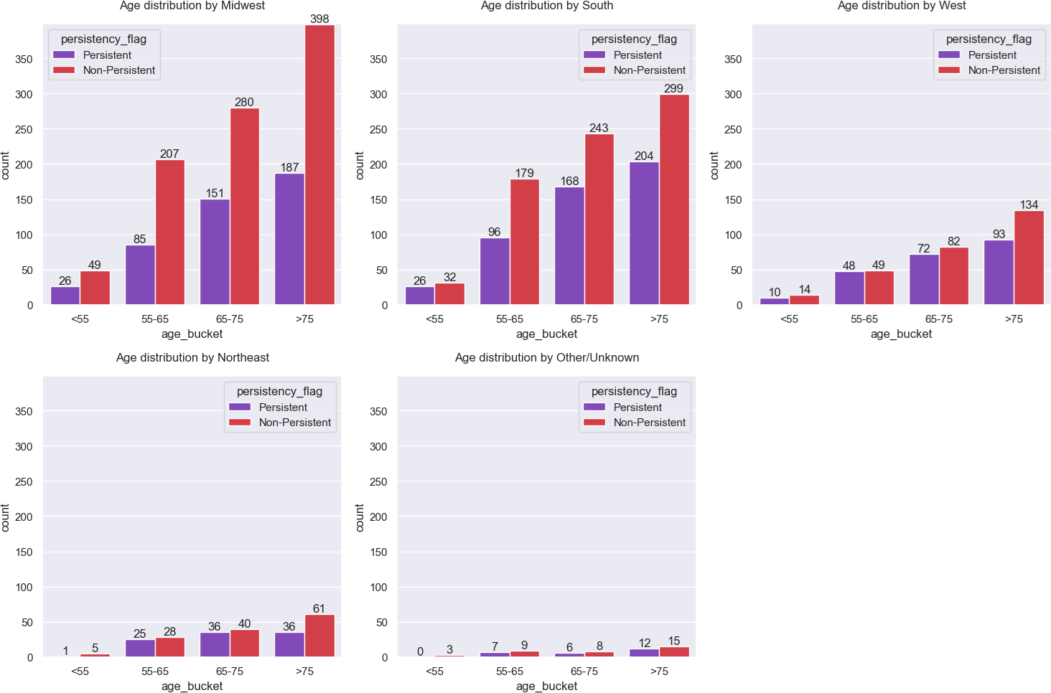
Demographic Data
Majority of Non-Persistent patients belong to the age group above 75 years in the Midwest region.

Slide 9
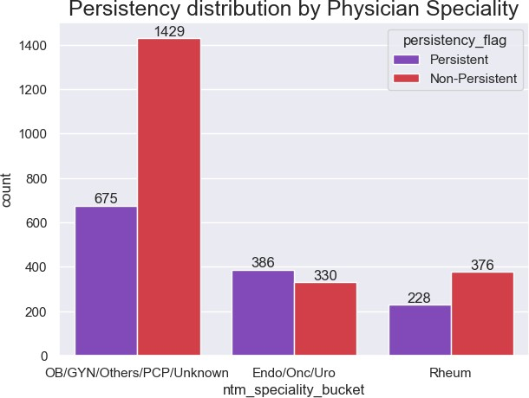
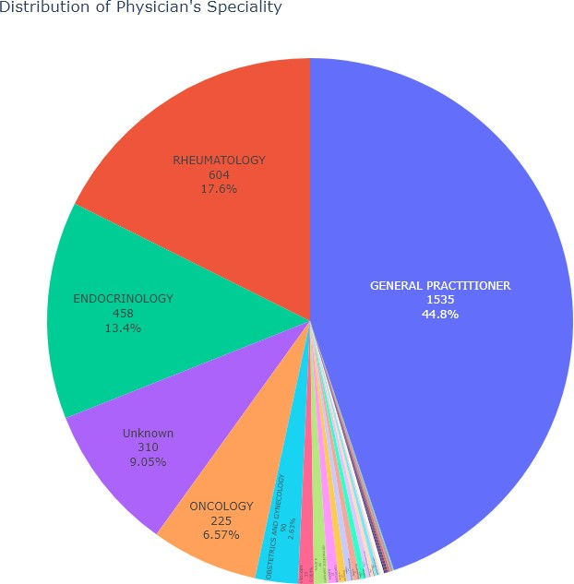
Physician Attributes
Around 45% of Physicians who have prescribed new medication to the patients are ‘General Practitioners’.

Slide 10
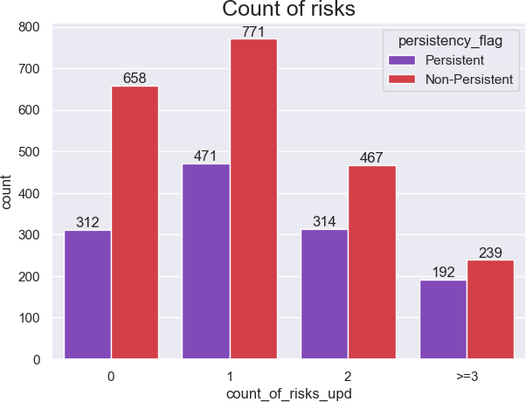
Risk Factors
As the number of risks per patient increases, the number of Non-Persistent patients decreases.

Slide 11
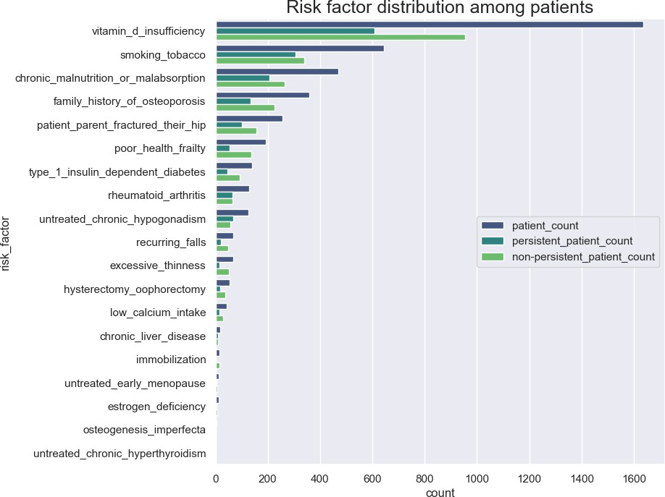
Risk Factors
Majority of the patients have been susceptible to Risk Factors such as ‘Vitamin D insufficiency’,
‘smoking tobacco’, ‘chronic malnutrition or malabsorption’ and have a ‘family history of osteoporosis’.
Due to heavy imbalance of data in Risk Factor categories, we can reduce dimensionality by reducing the categories capturing less data into a single category.

Slide 12
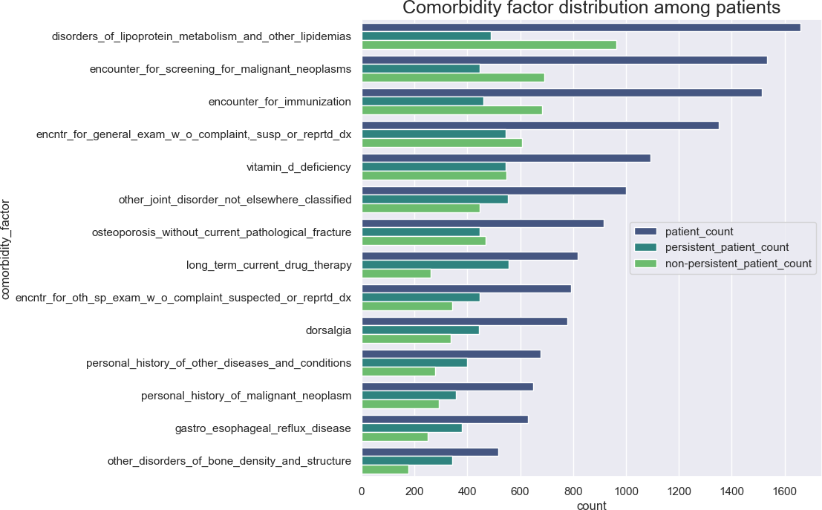
Comorbidity Factors
There are total 14 Comorbidity Factors recorded for each patient.
The top Comorbidity Factors include disorders_of_lipoprotein_metabolism_and_other_lipidemias,
encounter_for_screening_for_malignant_neoplasms, encounter_for_immunization, and
encntr_for_general_exam_w_o_complaint,_susp_or_reprtd_dx.

Slide 13
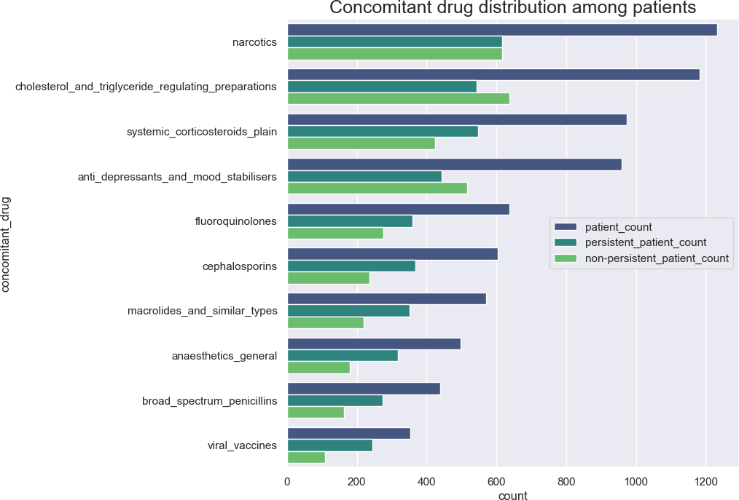
Concomitant Drugs
We can see that the graph shows the distribution of patients who have received Concomitant Drugs 1
year prior to start therapy.
The count for Non-Persistent patients who have been given Concomitant Drugs such as Narcotics, cholesterol_and_triglyceride_regulating_preparations, and anti_depressants_and_mood_stabilisers is greater compared to the other categories.

Slide 14
Model Building

Slide 15
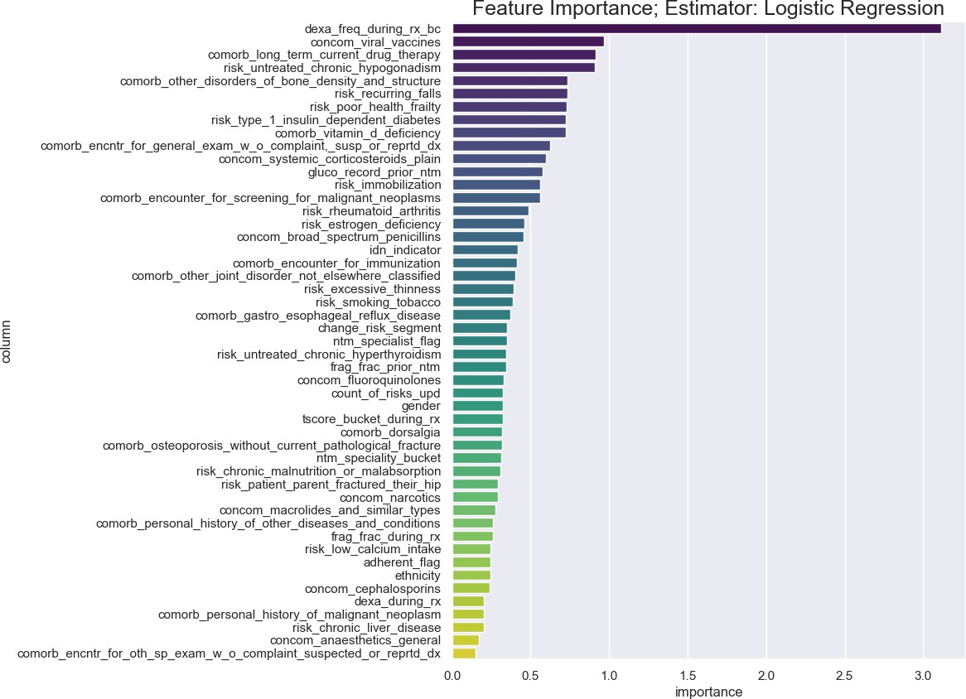
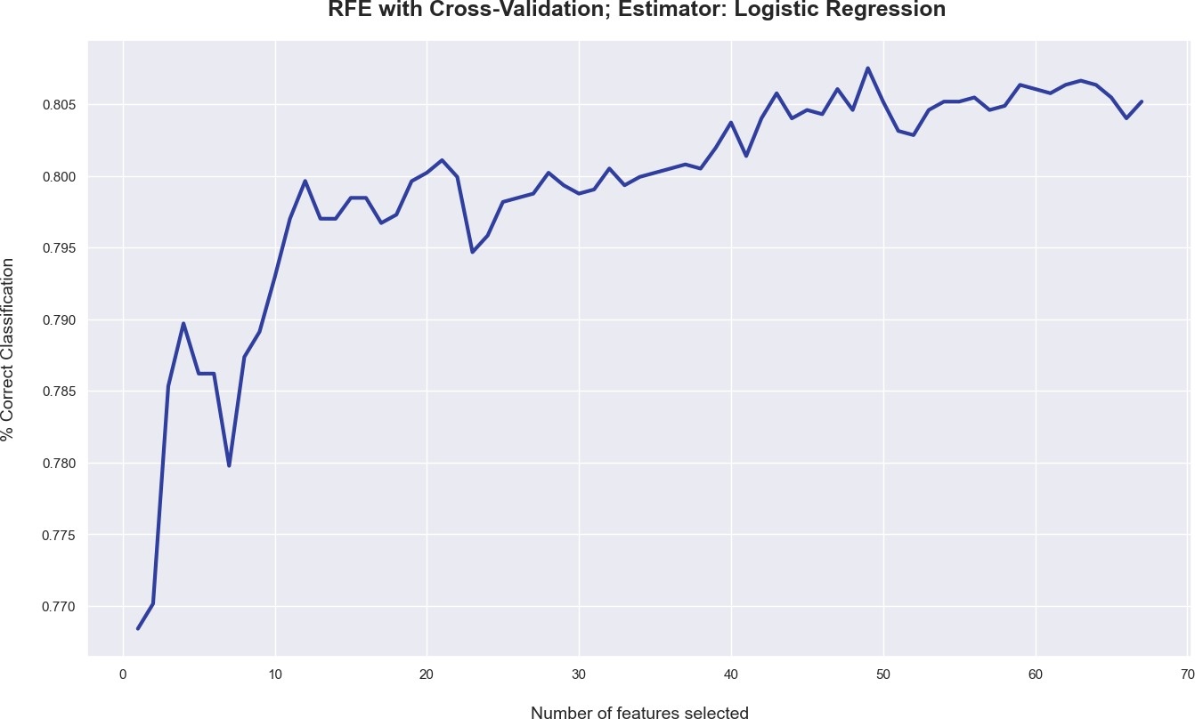
Feature Selection
Applied Recursive Feature Elimination with Cross Validation(RFECV) methods for feature selection.
Obtained 49 optimal features among which 14 features
were picked based on feature importance threshold of
0.5 for training the model.

Slide 16
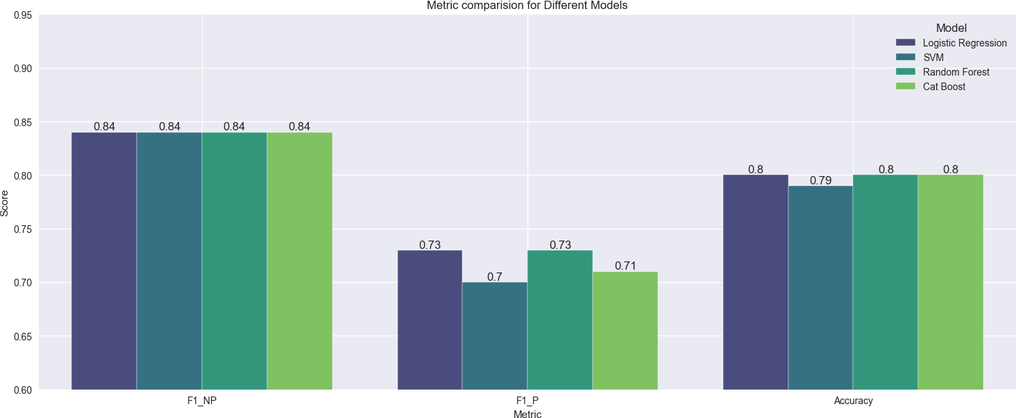
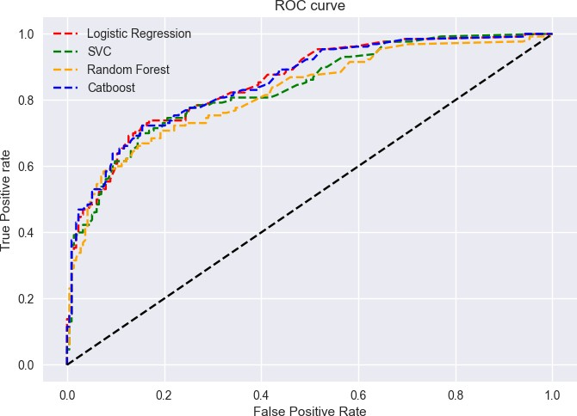
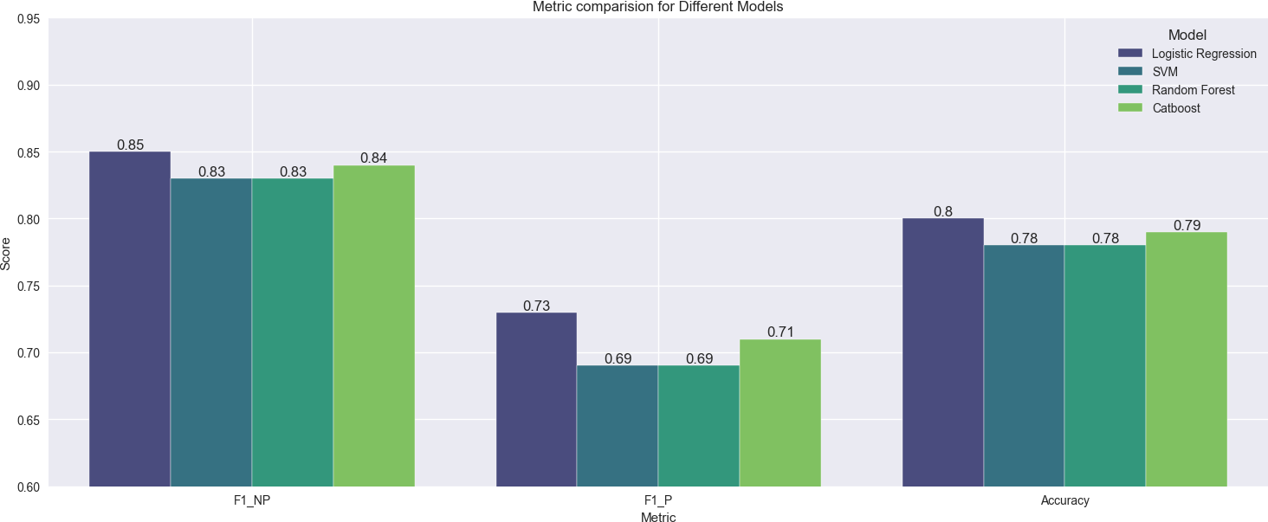
Model Evaluation and Selection
Trained 4 machine learning models – Logistic Regression, Random Forest Classifier, Support Vector Classifier and Catboost.
Logistic Regression performs better and generalises well on unseen data.

Slide 17
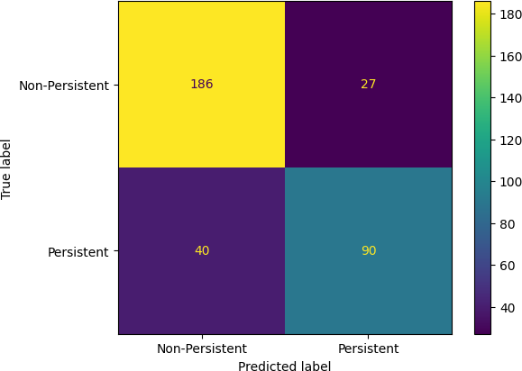
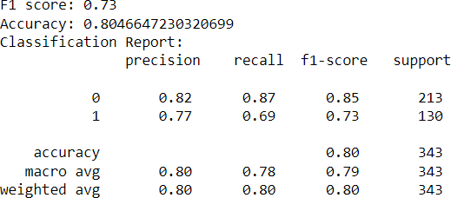
Model Evaluation and Selection
Confusion matrix along with Accuracy, Precision, Recall and F1-scores for Logistic Regression on test data.

Slide 18
Deployment

Slide 19



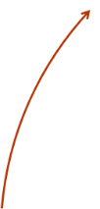
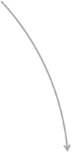




Architecture
Cloud
Container
Python Flask Framework
User Interface
Step 1: Enter
data
Step 4: Sending result to flask app
Step 2: Label encoding input values
Step 5: Display result
Result Prediction
Label Encoder
Step 3: Model prediction

Slide 20
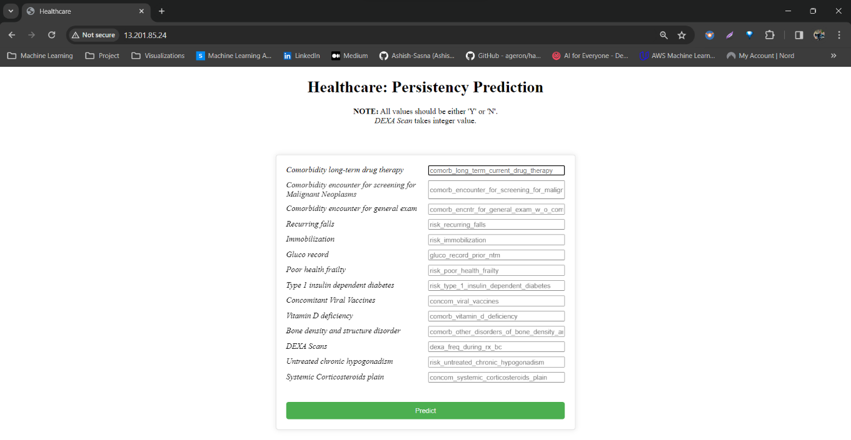
Homepage
The Homepage allows the end-users to enter the desired patient data for prediction.

Slide 21
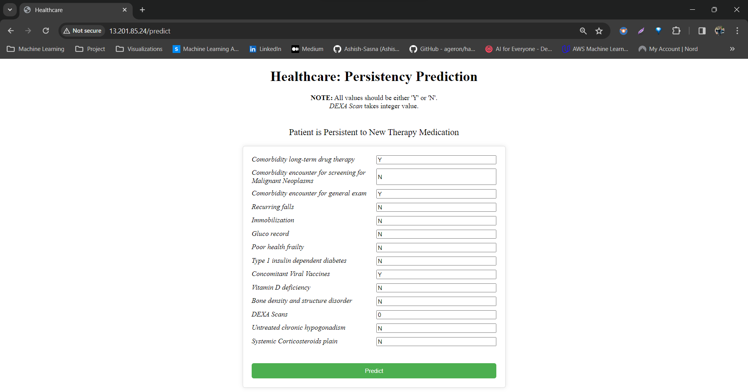
Homepage
The Predict/Result page shows the predicted result whether the patient is persistent to New Therapy Medication or not.

Slide 22
Thank You

